Slide 1
TypeScript
Creating and Using Generics
Lecture 6
By James(Jin) Wang
11/15/2021

Slide 2
Outline
Reusable code and generics
Functions
Interfaces
Classes
Constraints

Slide 3
Reusable code and generics
  Demo: Reusable code and generics

Slide 4
Generics and Functions
  Demo: Generics and Functions

Slide 5
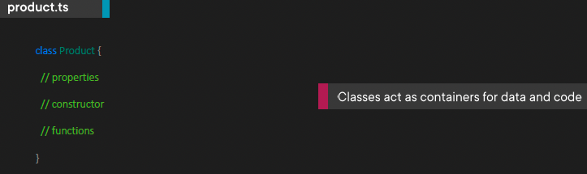
What is a Class
  Getting Started with Classes
  Classes can be used to encapsulate data and code.
  They act as templates for object instances.

Slide 6
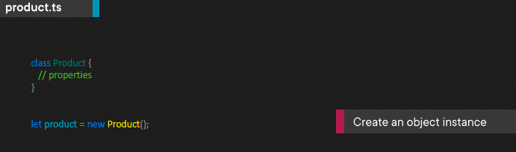
What is a Class
  Creating an Object Instance
  Classes act as templates that can be used to create object instances.

Slide 7
Creating and Using a Class
  Demo: Create and Use Class

Slide 8
Adding a Constructor and Properties
  Demo: Constructor and Property

Slide 9
Adding Functions
  Demo: Add Function

Slide 10
Extend Classes
  Demo: Extend Classes

Slide 11
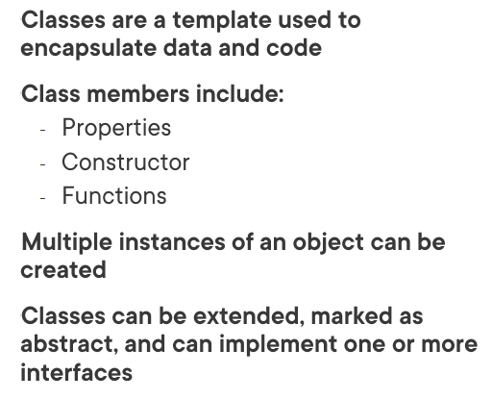
Summary

